Slide 1
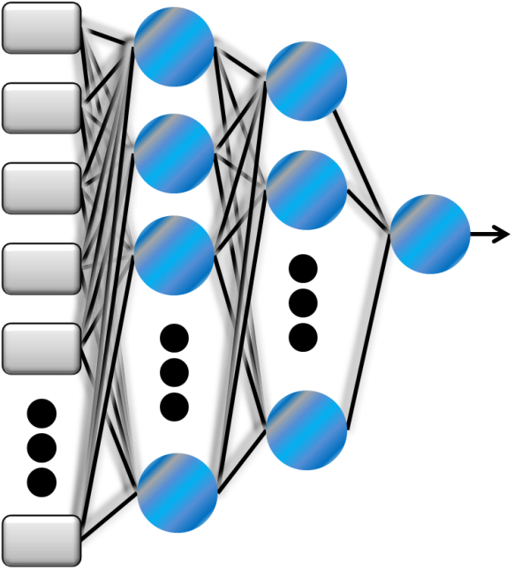
CSE 2500: Introduction to Discrete Systems
Lecture 22: Special Topics
Machine Learning Part 2
Kaleel Mahmood
Department of Computer Science and Engineering
University of Connecticut

Slide 2

The SET Survey
Please complete it here: https://blueapp.grove.ad.uconn.edu/Blue/
What you should consider:
Lectures NEVER went overtime, always concise and to the point.
We were the ONLY section of CSE 2500 to give students exposure to Python and special topics.
Only section of CSE 2500 taught using memes (probably).
Your feedback is appreciated.

Slide 3

Today’s Lecture Material
Strawberry Lecture Slides
Vanilla
White Board Derivations
Chocolate
Python
Coding

Slide 4
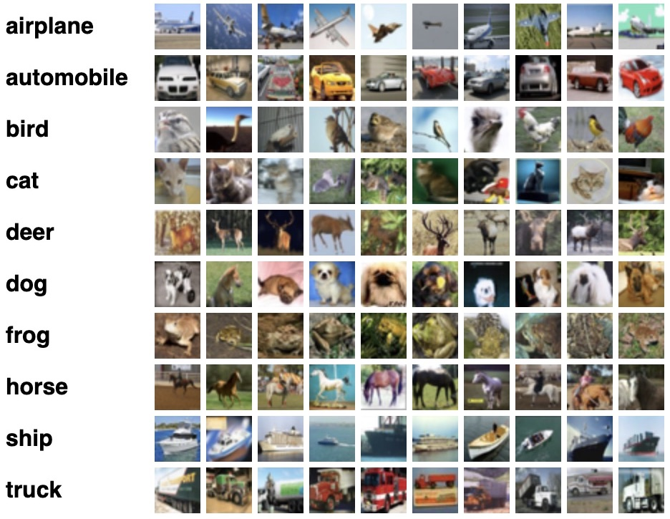



What is the main challenge in a machine learning problem?
$$W?$$
$$X$$
$$Y$$

Slide 5
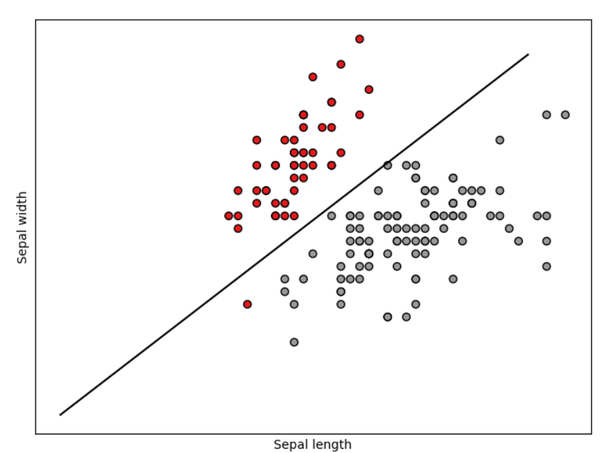
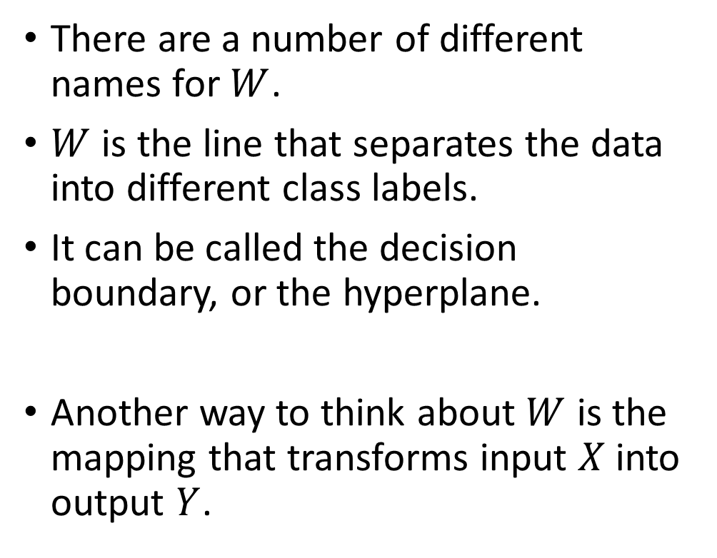
The Hyperplane
There are a number of different names for $W$.
$W$ is the line that separates the data into different class labels.
It can be called the decision boundary, or the hyperplane.
Another way to think about $W$ is the mapping that transforms input $X$ into output $Y$.

Slide 6
Machine learning data is multi-dimensional
Mathematical operations can be done in scalar, vector, matrix or tensor operations.
Scalar= A single number
$$x=5$$
Vector = A group of numbers in a 1D array.
E.g. time series data.
$$\vec{X}=[1,2,3,4,5]$$
$$X=\left[\begin{matrix}5 & 2 \\ 3 & 1\end{matrix}\right]$$
Matrix = A 2D array of data.
E.g. A black and white image.

Slide 7
Basic Matrix Operations
Matrix – a rectangular array of numbers, variables, and both
Order (dimensions) – describes the number of rows and columns in a matrix
Row 1
Row 2
4 5 6
3 7 8 10
This is a 2 x 4 matrix.
Rows
Columns
Column 1
Column 2
Column 3
Column 4

Slide 8

Review from last time…
What is the sum of A and B?
Matrices:
A+B?
Undefined! Matrix dimensions must be the same size to add together.

Slide 9

Matrix Multiplication – In order to multiply two matrices the columns of the first matrix must be equal to the rows of the second matrix.
[A] x [B]
(m x k) (k x n)
2x2
2x1
$$A=\left[\begin{matrix}1 & 2 \\ 3 & 4\end{matrix}\right] B=\left[\begin{matrix}5 \\ 6\end{matrix}\right]$$

Slide 10
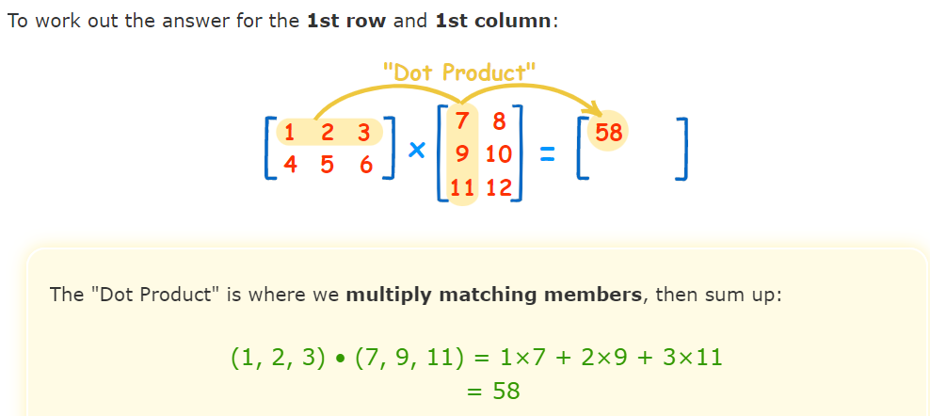
Matrix Multiplication: Go row by column
Source: https://www.mathsisfun.com/algebra/matrix-multiplying.html

Slide 11
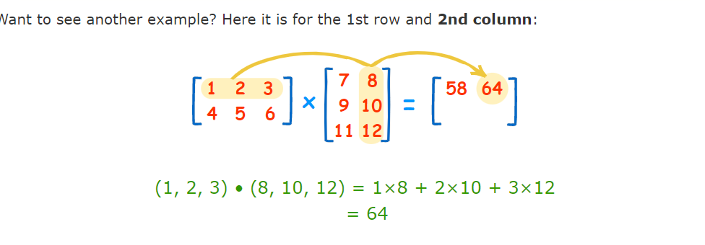
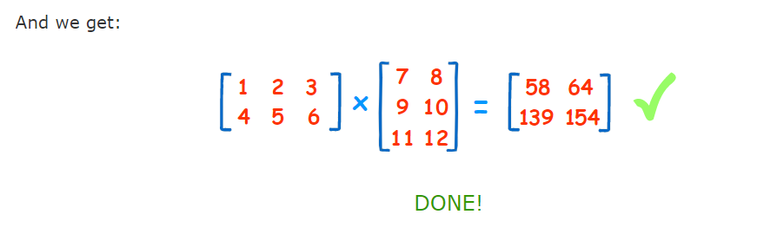
Matrix Multiplication: Go row by column

Slide 12
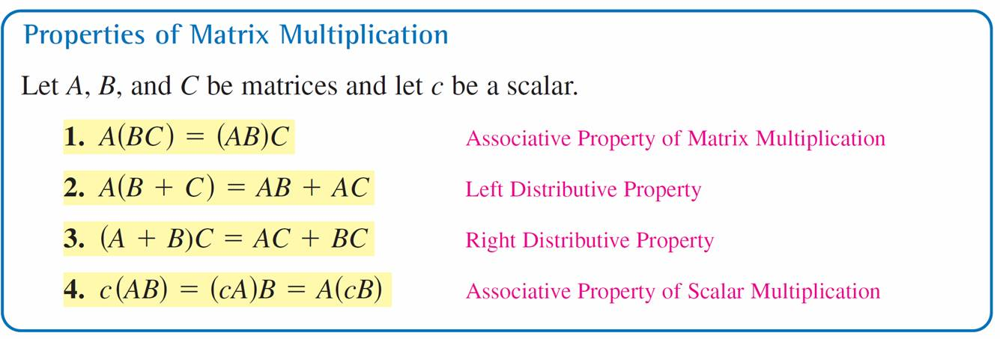

Matrix Multiplication Properties
NOTE: $AB ≠BA$ for matrices

Slide 13
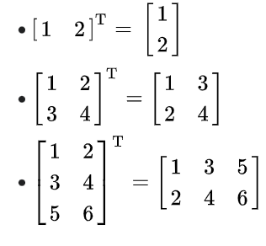
A few more matrix properties…
Matrix Transpose
Source: https://en.wikipedia.org/wiki/Transpose

Slide 14



Transpose Properties
Where would the transpose operation be useful?

Slide 15
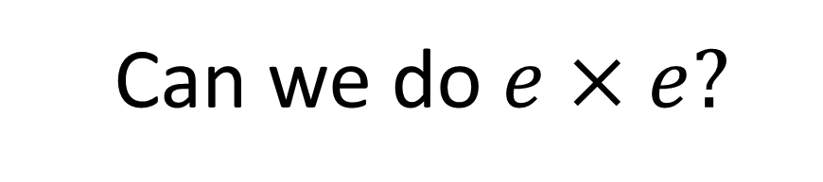

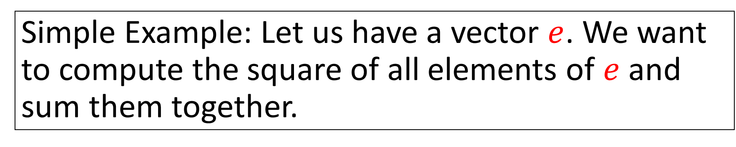

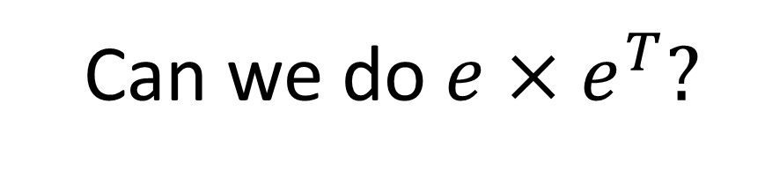
Simple Example: Let us have a vector $e$. We want to compute the square of all elements of $e$ and sum them together.
$$e=$$
Can we do $e×e?$
Can we do $e×e^{T}?$
$$×$$

Slide 16
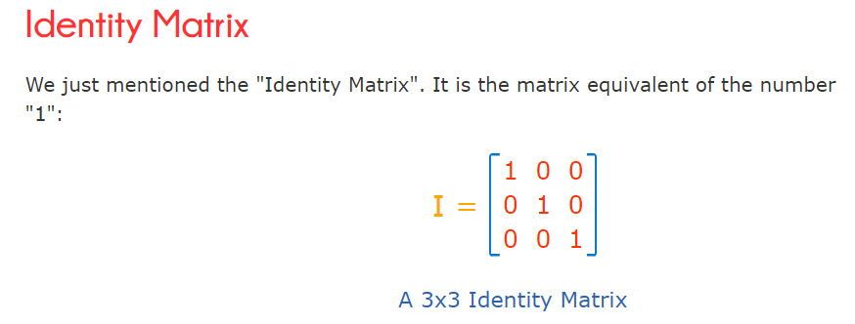
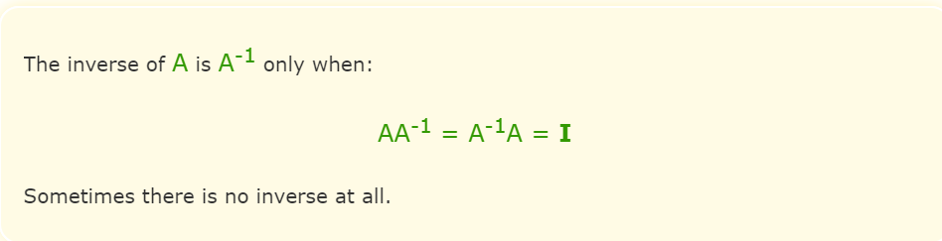
Matrix Inverse and Identity Matrix

Slide 17
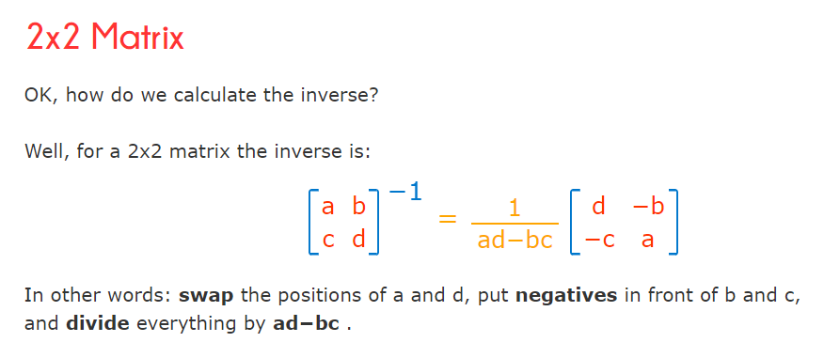
Computing a Matrix Inverse

Slide 18
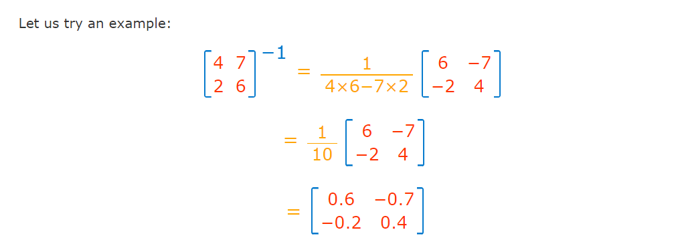
Computing a Matrix Inverse Example
But how do we know that this is indeed the inverse of the given matrix?

Slide 19

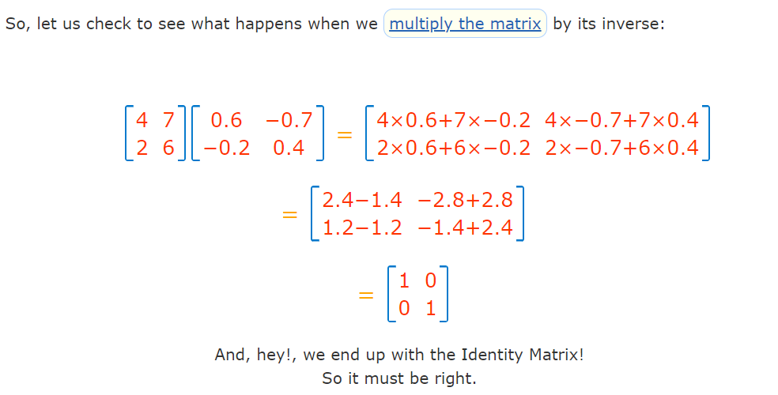

Slide 20

Where would we need to use the matrix inverse?
$$A=B×C$$
In matrix form assume that A is known and C is known. Can you find B?
$$A×C^{−1}=B×C×C^{−1}$$
$$A×C^{−1}=B×I$$
$$A×C^{−1}=B$$

Slide 21
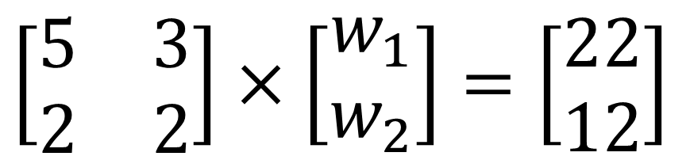
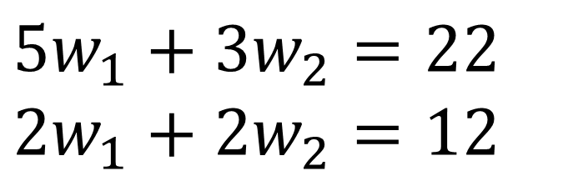


Use of the matrix inverse: Solve for multiple variables
Express the following equations in matrix form:
$$\left[\begin{matrix}5 & 3 \\ 2 & 2\end{matrix}\right]×\left[\begin{matrix}w_{1} \\ w_{2}\end{matrix}\right]=\left[\begin{matrix}22 \\ 12\end{matrix}\right]$$
$$5w_{1}+3w_{2}=22$$
$$2w_{1}+2w_{2}=12$$
$$X×W=Y$$
$$W=X^{−1}Y$$

Slide 22

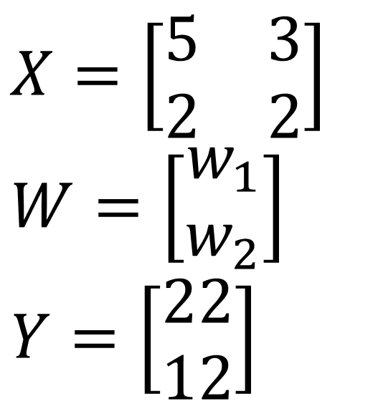
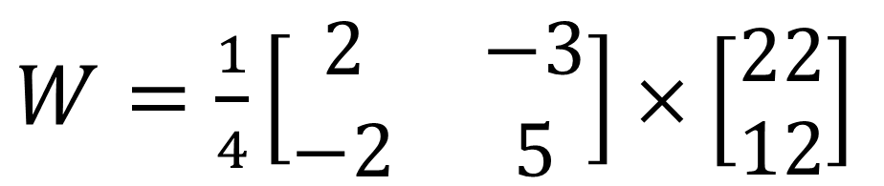
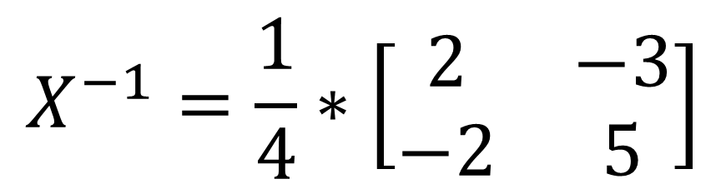
Use of the matrix inverse: Solve for multiple variables
$$W=X^{−1}Y$$
$$X=\left[\begin{matrix}5 & 3 \\ 2 & 2\end{matrix}\right]$$
$$W=\left[\begin{matrix}w_{1} \\ w_{2}\end{matrix}\right]$$
$$Y=\left[\begin{matrix}22 \\ 12\end{matrix}\right]$$
$$X^{−1}=\frac{1}{4}∗\left[\begin{matrix}2 & −3 \\ −2 & 5\end{matrix}\right]$$
$W=\frac{1}{4}\left[\begin{matrix}2 & −3 \\ −2 & 5\end{matrix}\right]×$ $\left[\begin{matrix}22 \\ 12\end{matrix}\right]$
$$X^{−1}$$
$$Y$$

Slide 23


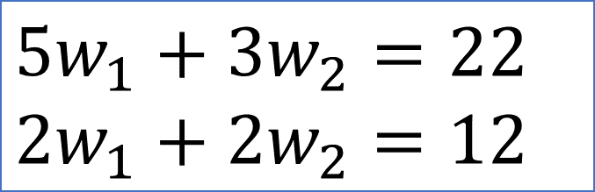

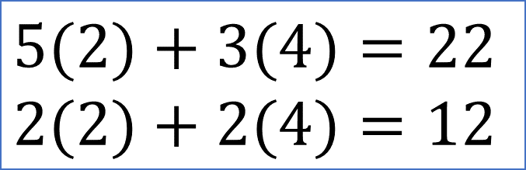
Use of the matrix inverse: Solve for multiple variables
$W=\frac{1}{4}\left[\begin{matrix}2 & −3 \\ −2 & 5\end{matrix}\right]×$ $\left[\begin{matrix}22 \\ 12\end{matrix}\right]=\left[\begin{matrix}2 \\ 4\end{matrix}\right]$
$$5w_{1}+3w_{2}=22$$
$$2w_{1}+2w_{2}=12$$
$$5(2)+3(4)=22$$
$$2(2)+2(4)=12$$

Slide 24

What did Spiderman mean when he said this?
“With great power comes great responsibility.”
– Spiderman
Most likely he was talking about the power of the linear regression derivation.

Slide 25
Whiteboard derivation

Slide 26
Coding Example in Python

Slide 27
Figure Sources
https://gumlet.assettype.com/freepressjournal/2021-11/73de02ef-cd36-47d8-bbae-528d01dc6fe4/f89U3ADr1oiB1s9GkdPOEpXUk5H.jpg?format=webp&w=400&dpr=2.6
https://i.kym-cdn.com/photos/images/facebook/000/714/989/adc.jpg
https://www.azquotes.com/picture-quotes/quote-no-one-man-should-have-all-that-power-kanye-west-85-46-66.jpg
https://static.rogerebert.com/redactor_assets/pictures/far-flung-correspondents/with-great-power-comes-great-responsibility/spiderman2_big-decision.jpg
Matrix Slides from: https://www.johnston.k12.nc.us/cms/lib/NC02214550/Centricity/Domain/5199/Online%20Ch3.ppt
https://www.murrieta.k12.ca.us/cms/lib/CA01000508/Centricity/Domain/1467/Section%207.5%20version%202%20AM.ppt

Slide 28
Figure Sources 2
https://www.thesun.co.uk/wp-content/uploads/2016/06/nintchdbpict000242185564.jpg
https://www.memecreator.org/static/images/memes/4217960.jpg
https://i.kym-cdn.com/photos/images/newsfeed/001/859/829/b82.png
Matrix Slides from: https://www.johnston.k12.nc.us/cms/lib/NC02214550/Centricity/Domain/5199/Online%20Ch3.ppt
https://www.murrieta.k12.ca.us/cms/lib/CA01000508/Centricity/Domain/1467/Section%207.5%20version%202%20AM.ppt

